Slide 1
GenAI
Introduction to GenAI and Prompts

Slide 2
What is Artificial Intelligence
computer systems designed to simulate human intelligence
analyse data, recognize patterns, and make decisions with minimal human intervention
Type | Description | Examples
Narrow AI (Weak AI) | Specialized systems focused on one task | Siri, Google Search, Netflix recommendations
General AI (Strong AI) | Hypothetical machines with human-like intelligence across domains | Not yet achieved
Superintelligent AI | Beyond human intelligence, capable of outperforming humans in all tasks | Still theoretical

Slide 3

GenAI - Generative AI
AI systems that can produce novel content in response to prompts
Difference from Traditional AI:
  Predictive AI → Focuses on classification (spam vs. not spam).
  Generative AI → Creates new data (a poem, a painting, a song).
How it Works:
  Trained on massive datasets (text, images, audio, video).
  Uses deep learning and neural networks to identify patterns.
  Generates new outputs by predicting what comes next in a sequence (e.g., words in a sentence, pixels in an image)

Slide 4
Applications of GenAI
Domain | Examples
Text | Chatbots, automated writing, summarization
Images | AI art, design mockups, product visualization
Audio | Music composition, voice synthesis
Video | Short clips, animations, marketing content
Code | AI-assisted programming, bug fixing

Slide 5
Benefits of GenAI
Creativity Boost: Helps artists, writers, and developers brainstorm ideas.
Efficiency: Automates repetitive tasks like drafting emails or generating reports.
Accessibility: Makes complex tools (design, coding) easier for non-experts.
Personalization: Tailors recommendations, ads, and learning materials.

Slide 6

Why GenAI Matters Today
Productivity Gains: reduces the time needed for tasks like writing, coding, and designing
Creativity & Innovation: empowers creators to explore new ideas
Accessibility: Tools like ChatGPT or image generators make complex skills (writing, coding, design) accessible to non-experts, democratizing creativity
Business Transformation: Organizations are using GenAI to streamline workflows, personalize customer experiences, and innovate in areas like healthcare, finance, and education
Technology Evolution: GenAI is driving advancements in embedded systems, IoT, and digital innovation, making it a catalyst for the next wave of technological progress

Slide 7
Key GenAI Skills Employers Want
Skill Area | Why It Matters | Examples of Roles
Prompt Engineering | Crafting effective inputs for GenAI models | AI Prompt Engineer, UX Designer
AI Governance & Ethics | Ensuring responsible and compliant AI use | AI Governance Specialist, Compliance Officer
Machine Learning & Data Science | Building and training models | ML Engineer, Data Scientist
Generative Model Deployment | Applying GenAI in real-world systems | AI Product Manager, Cloud Engineer
Critical Thinking & Adaptability | Applying AI responsibly in business contexts | Business Analyst, Strategy Consultant

Slide 8
Popular GenAI Tools
Text: ChatGPT, Microsoft Copilot, Google Gemini
Code: GitHub Copilot, Code4Eclipse
Images: DALL·E, Stable Diffusion
Business Apps: Copilot in Word, Excel, PowerPoint

Slide 9

GitHub Copilot
AI-powered coding assistant developed by GitHub & OpenAI
Suggests code, functions, and documentation in real time

Slide 10
Key Features
Code Autocompletion: Functions, loops, boilerplate code
Documentation Generation: Explains code snippets
Test Creation: Suggests unit tests automatically
Chat Interface: Conversational coding support (Copilot Chat)
Multi-File Understanding: Context across entire projects

Slide 11
Github Copilot Integration
Visual Studio Code
JetBrains IDEs
Neovim
Eclipse (via Copilot4Eclipse plugin)

Slide 12
Prompts: The Language of Generative AI
A prompt is the input (text, image, or instruction) given to an AI model
It guides the AI to generate relevant responses
Prompts are the bridge between human intent and AI output

Slide 13
Why Prompts Matter
Precision: Better prompts = more accurate outputs.
Creativity: Prompts unlock AI’s ability to generate unique ideas.
Efficiency: Saves time by reducing trial-and-error.
Control: Helps steer AI toward desired tone, style, or format.

Slide 14
Types of Prompts
Type | Description | Example
Instructional | Direct commands | “Write a Python function for factorial”
Descriptive | Detailed context | “Describe the Eiffel Tower at sunset in poetic style”
Conversational | Natural dialogue | “Explain quantum physics like I’m 10 years old”
Few-shot | Includes examples for guidance | “Translate: Hello → Hola, Goodbye → Adiós”
Multimodal | Combines text + image/audio | “Generate a caption for this photo”

Slide 15
Anatomy of a Good Prompt
Clarity: Be specific about what you want
Context: Provide background or examples
Constraints: Define format, length, or style
Audience: Tailor output to intended readers/users
Example:
Weak Prompt - “Write about AI.”
Strong Prompt - “Write a 200-word blog post explaining AI to high school students, using simple examples.”

Slide 16
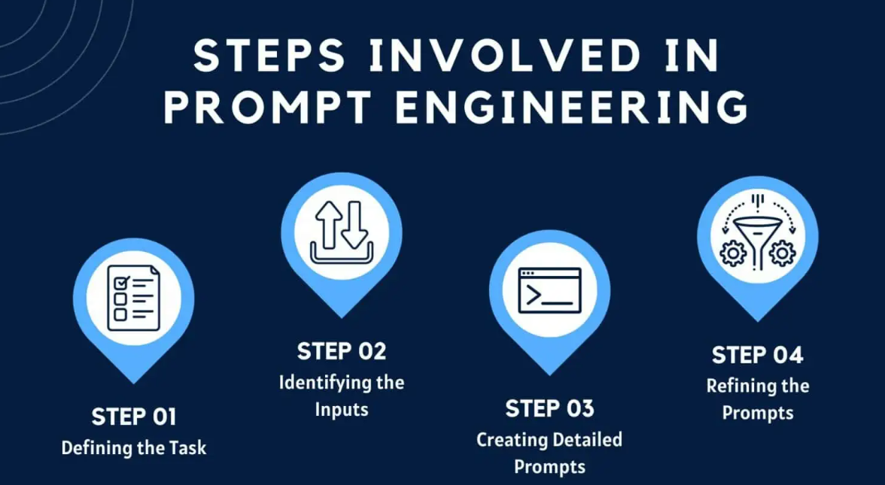
Prompt Engineering
The practice of designing effective prompts to optimize AI outputs
Combines clarity, context, and creativity
Key skill for developers, analysts, and designers

Slide 17
Why Prompt Engineering Matters
Better prompts = better results.
Saves time and effort.
Helps avoid wrong or irrelevant answers.
Essential for coding, documentation, design, and learning.

Slide 18
Principles of Good Prompting
Clarity
  Prompts should be easy to understand, with no ambiguity
  Why: AI struggles with vague or confusing instructions
  Examples:
    Bad: “Write code.”
    Good: “Write a Java program that takes user input and prints it in reverse order.”

Slide 19
Principles of Good Prompting
Context
  Provide background or details so AI understands the situation
  Why: Context helps AI tailor the response to your needs
Examples:
  Bad: “Explain inheritance.”
  Good: “Explain inheritance in Java with a simple example using classes Animal and Dog.”

Slide 20
Principles of Good Prompting
Specificity
  Define exactly what you want — format, length, style, or audience
  Why: Specific prompts reduce irrelevant or overly broad answers
Examples:
  Bad: “Explain AI.”
  Good: “Explain AI in simple terms with 3 real-world examples, in less than 100 words.”

Slide 21
Principles of Good Prompting
Step-by-Step Instructions
  Break complex tasks into smaller steps
  Why: AI performs better when guided through stages
Examples:
  Bad: “Write a program for banking system.”
  Good:
    “First, create a class Account with balance.”
    “Next, add deposit and withdraw methods.”
    “Finally, write a main method to test the class.”

Slide 22
Principles of Good Prompting
Role Prompting
  Ask AI to take on a role for better perspective
  Why: Role prompts shape the style and tone of responses
Examples:
  “Act as a Java tutor and explain polymorphism with examples.”
  “Act as a project manager and draft a daily status report.”

Slide 23
Principles of Good Prompting
Format Guidance
  Tell AI how to structure the output
  Why: Ensures answers are easy to read and usable
Examples:
  “Explain OOP concepts in a table with columns: Concept, Definition, Example.”
  “Summarize this article in 5 bullet points.”

Slide 24
Principles of Good Prompting
Constraints
  Limit the scope (word count, style, tone)
  Why: Keeps output concise and aligned with your needs
Examples:
  “Explain recursion in less than 50 words.”
  “Write a professional email in a polite tone, under 5 sentences.”

Slide 25
Problems Faced while Writing Prompts
Vague Prompts - Prompts that are too general lead to irrelevant or incomplete answers
Lack of Context - Without background information, AI gives generic responses
Overly Complex Prompts - Asking for too much in one prompt confuses AI
Ambiguity in Language - Using unclear words or multiple meanings leads to wrong outputs
Ignoring Output Format - If you don’t specify format, AI may give long paragraphs instead of structured answers
Unrealistic Expectations - Expecting AI to know everything or give perfect answers
Ignoring Verification - Blindly trusting AI outputs without checking correctness
Too Short or Too Long Prompts - Too short → AI doesn’t understand;Too long → AI gets confused

Slide 26
GenAI – Best Practices
Clarity of Prompts - Clear, detailed prompts yield better results
Human Oversight - Review outputs carefully: AI suggestions may contain errors or biases
Never fully automate critical tasks - Keep humans in the loop for decision-making
Validate accuracy - Cross-check with trusted sources before using AI-generated content
Data & Security - Use secure environments - Ensure AI tools comply with organizational policies
Protect intellectual property - Avoid exposing proprietary code or documents

